Slide 1
Crime Prediction & Analysis - Sanfrancisco

Slide 2
Group 9
Bindia Bindia – 0782850
Mohammed Adhil Ghouse Mohiuddin Tahir – 0780564
Piyush Piyush - 0789965

Slide 3

introduction
The city of San Francisco has a lot of crime, with numerous different types of crimes being reported every day. Residents' safety and security are the responsibility of the local law enforcement agencies, but there is a need for a more proactive strategy to fight crime. In order to predict future crimes and enhance the efficiency of law enforcement activities, the project will analyse crime data to find patterns and trends.
Using a collection of crime data from the real world, locate spatial and temporal hotspots for crime.
Identify the trend pattern what kind of crime might happen and which is the safest place to live in

Slide 4
why do we do crime prediction
This project aims to analyze crime patterns in San Francisco and develop a model to predict the likelihood of crimes occurring in different areas of the city. The dataset used for this project is the San Francisco Crime Classification dataset, which contains information about crimes that occurred between 2018 and 2023.

Slide 5
Dataset
San Francisco crime dataset from 2015-01-01 to 2023-03-31
Police Department Incident Reports: 2018 to Present | DataSF | City and County of San Francisco (sfgov.org)

Slide 6
Overview
DATA CLEANING AND PRE-PROCESSING
Dataset is cleaned, missing values are handled, and new features are created to help with the analysis.
EXPLORATORY DATA
ANALYSIS
The second part of the project involves exploratory data analysis (EDA) to gain insights into the data and identify patterns and trends in crime incidents. This will involve visualizing the data using charts, graphs, and maps to identify hotspots and patterns in crime incidents.
MACHINE LEARNING MODELS
In the third part of the project, machine learning models will be developed to predict the likelihood of crimes occurring in different areas of the city.

Slide 7
timeline
JUNE 1st TO 3RD WEEK 2023
Exploratory Data Ananlysis
May 2nd TO 5th WEEK 2023
Research and Data cleaning
JUNE 4TH TO 5TH WEEK 2023
Development of machine learning models
JULY 1ST WEEK
Implementation of Models
JULY 2ND WEEK
Final Project Submission

Slide 8
areas of focus
Dash board creation
Develop weather data and show an impact on crime
Develop and implementation of models
Random Forest Regressors
Neural Networks

Slide 9
Challenges
Critical dataset
Ml model developing

Slide 10
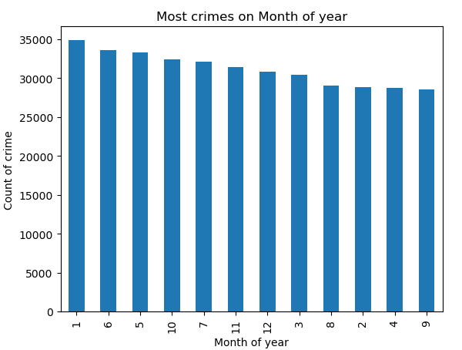
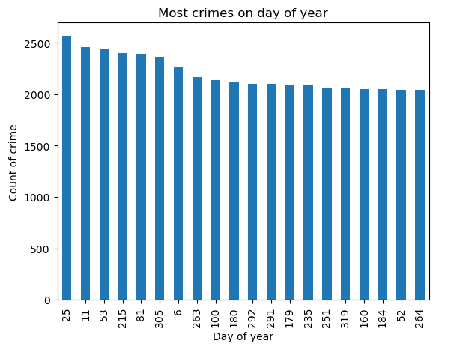
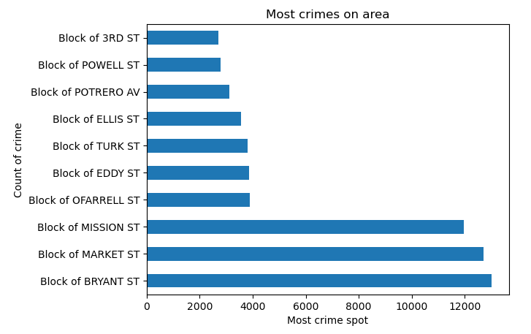
Analysis
Most Number of crimes happened in month of the year
Most Number of crimes happened in the area
Most Number of crimes happened in day of the year

Slide 11
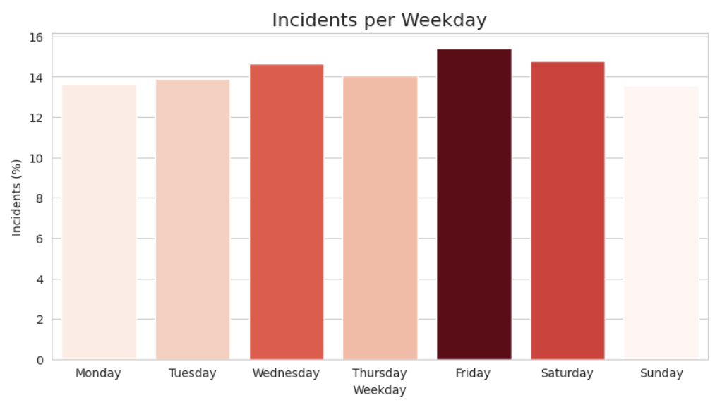
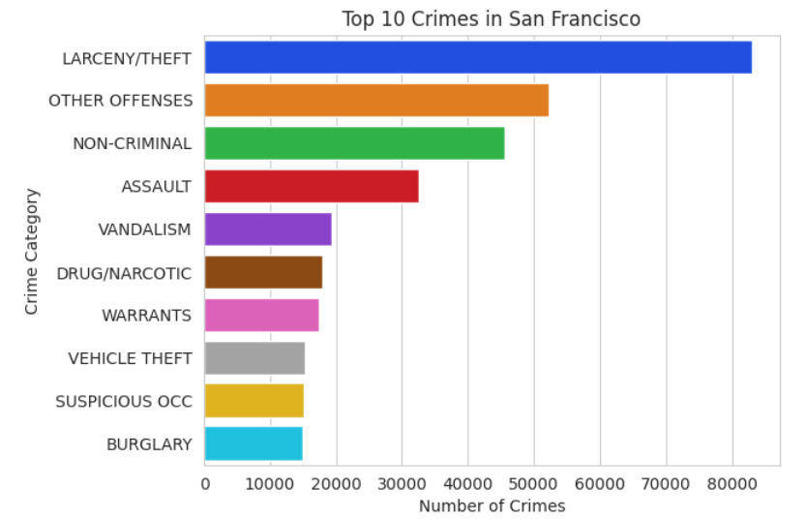
Analysis
Most Number of crimes happened in week
Top 10 crimes in San francisco
Most Number of crimes happened in the area

Slide 12
Machine Learning Models
The models used in the table are Random Forest, Support Vector Machine (SVM), K-Nearest Neighbor (KNN), Neural Network, and Naive Bayes. The accuracy scores range from 0.15 to 0.33, with Random Forest having the highest accuracy score of 0.33, and KNN having the lowest accuracy score of 0.15
--+------------------------------------------+------------------+
| | Model_Name using Counter_vector Method | Accuracy Score |
+====+==========================================+==================+
| 0 | Random Forest Model | 0.33 |
+----+------------------------------------------+------------------+
| 1 | Support machine vector SVM | 0.26 |
+----+------------------------------------------+------------------+
| 2 | KNN | 0.15 |
+----+------------------------------------------+------------------+
| 3 | Neural Network | 0.27 |
+----+------------------------------------------+------------------+
| 4 | Naive Bayes | 0.28 |
+----+------------------------------------------+------------------+

Slide 13
Continuation to EDA, Preprocessing & Feature Engineering
Temporal and spatial factors
Contextual data
Feature selection techniques
Address class imbalance
Regularize and tune hyperparameters
Evaluate model performance on different metrics

Slide 14
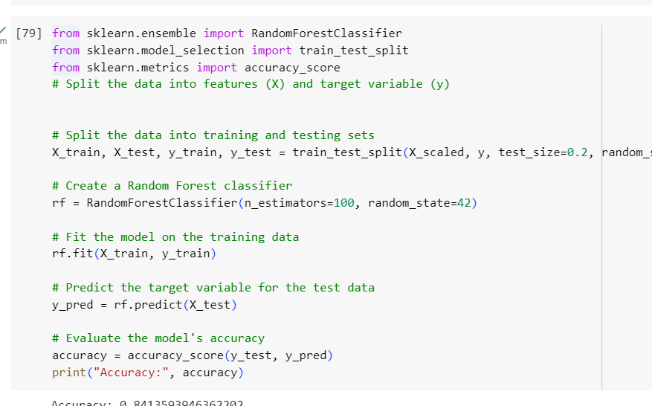
Testing the model

Slide 15
Next Steps
Implementation of Neural Network
Creation of Dashboard
Compare weather data to see an impact on Crime

Slide 16
Thankyou

